Slide 1
Introduction of gait and mobility
Farhan shah
Demonstrator P&O
KMU Peshawar

Slide 2
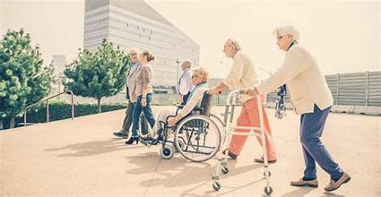
Mobility
Mobility refers to the ability to move or be moved freely and easily. It can refer to physical movement, such as the capacity of individuals to walk or use transportation, as well as broader concepts like social mobility or economic mobility, which describe the ability to change one's social or economic status.
If you want to get stronger, faster, and healthier, your recovery and mobility are just as important as your workouts

Slide 3
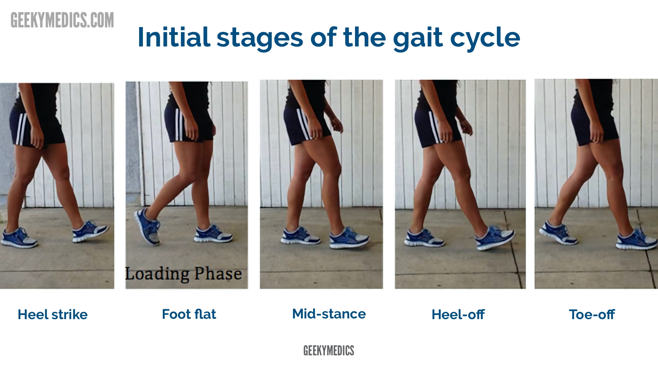
GAIT
Gait is the walking pattern in humans that involves complex interactions of nervous, musculoskeletal and cardiorespiratory systems
The gait cycle refers to the sequence of events that occur from the initial contact of one foot with the ground until the same foot contacts the ground again. It is typically divided into two main phases: the stance phase (when the foot is on the ground) and the swing phase (when the foot is in the air)

Slide 4
Gait Analysis
The analysis of the gait cycle is important in the biomechanical mobility examination to gain information about lower limb dysfunction in dynamic movement and loading.
When analyzing the gait cycle, it is best to examine one joint at a time.
Objective and subjective methods can be used.

Slide 5
Subjective
Different gait patterns - We might ask the individual to walk normally, on insides and outsides of feet, in a straight line, running (all the time looking to compare sides and understanding of "normal").
Ask/observe the type of footwear the patient uses (a systematic review suggests shoes affect velocity, step time, and step length in younger children's gait

Slide 6
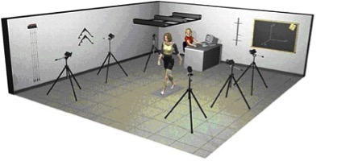
Objective
An objective approach is quantitative and parameters like time, distance, and muscle activity will be measured. Other objective methods to assess the gait cycle that use equipment include:
Video Analysis and Treadmill
Electronic and Computerized Apparatus
Electronic Pedometers
Satellite Positioning System

Slide 7
Qualitative methods
Qualitative methods to assess and analyze gait include:
Rancho Los Amigos Hospital Rating List
Ten Meter Walking Test
6 Minute Walk Test
2 Minute Walk Test
Dynamic Gait Index
Emory Functional Ambulation Profile
Timed Up and Go Test This test is statistically associated with falling in men, but not in women.
Functional Ambulation Categories
Tinetti-Test

Slide 8
Gait analysis systems
Basically, there are 5 measurement systems.
Three of these focus on the specific events that constitute the act of walking.
1.motion analysis : defines the magnitude and timing of individual joint movements
2.dynamic EMG identifies the period and timing of individual joint movements.
3.force plate recordings display the functional demands being experienced during the weight bearing period.
Each system serves as a diagnostic techniques for one facet of gait

Slide 9
The 2 remaining gait analysis techniques summarize the effects of the person’s gait mechanics .
One measures the patient’s stride characteristics to determine overall walking capability , while efficiency is revealed by energy cost measurements.
There are several choices of technique within each of these 5 basic measurement systems.
These differ in cost ,convenience, and completeness of the data provided.

Slide 10
There is not a single optimal system ,selections are based on the needs ,staffing and finances of the particular clinical or research situation.
Observational gait analysis can be used to guide decision making regarding the particular data (system)required to differentiate the gait pathology ,underlying causes, and functional consequences

Slide 11
THANKS…

